Slide 1
Spatial domain
2D mesh
point records
sampling effort
agriculture
2D Matern function
cell size
PC1
forest
distribution
of alive individuals
PC2
urban
PC3
wetlands
PC4
hedgerows
(a) exposure model
speed
traffic
*100 replicates
roadkills point pattern
distribution of roadkills
(c) risk model
roads
buffer 1km
Cell size
2D mesh
Barrier function
predictive mapping
inference on processes
(b) danger model
(d) outputs

Slide 2
Number of records
Number of sampling dates
Spatial domain
2D mesh
Number of observers
Number of species
2D Matern function
cell size
S1
agriculture
PC1
forest
PC2
Exposure
sampling
Alive animal records
urban
PC3
wetlands
PC4
hedgerows
Roadkill risk
Roadkill records
speed
traffic
Danger
roads
buffer 1km
Cell size
2D mesh
Barrier function

Slide 3




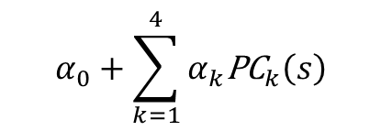

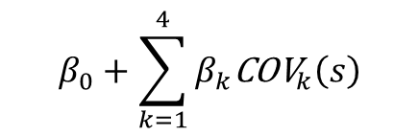


Parameters and hyperparameters
$$α_{0}+\sum_{k=1}^{4}{α_{k}{\text{PC}}_{k}\left(s\right)}$$
$$β_{0}+\sum_{k=1}^{4}{β_{k}{\text{COV}}_{k}\left(s\right)}$$
$$\left(ρ^{\text{lv}} , σ^{\text{lv}}\right)$$
$$\left(ρ^{\text{rk}} , σ^{\text{rk}}\right)$$
$$α_{5}\text{SAMPLING}\left(s\right)$$
Spatial
random effects
W
Z
Risk model
$$Λ_{i}^{R}\left(s\right)=Λ_{i}^{E}\left(s\right)×Λ_{i}^{D}\left(s\right)$$
$$Λ_{i}^{\text{lv}}\left(s\right)$$
Observed data
$$Y_{i}^{\text{rk}}\left(s\right)$$
$$Y_{i}^{\text{lv}}\left(s\right)$$

